Slide 1

Python programming
Introduction to
For beginner
By: Bon Lee

Slide 2

Further learning
Python programming
Advanced Language Features
By: Bon Lee

Slide 3
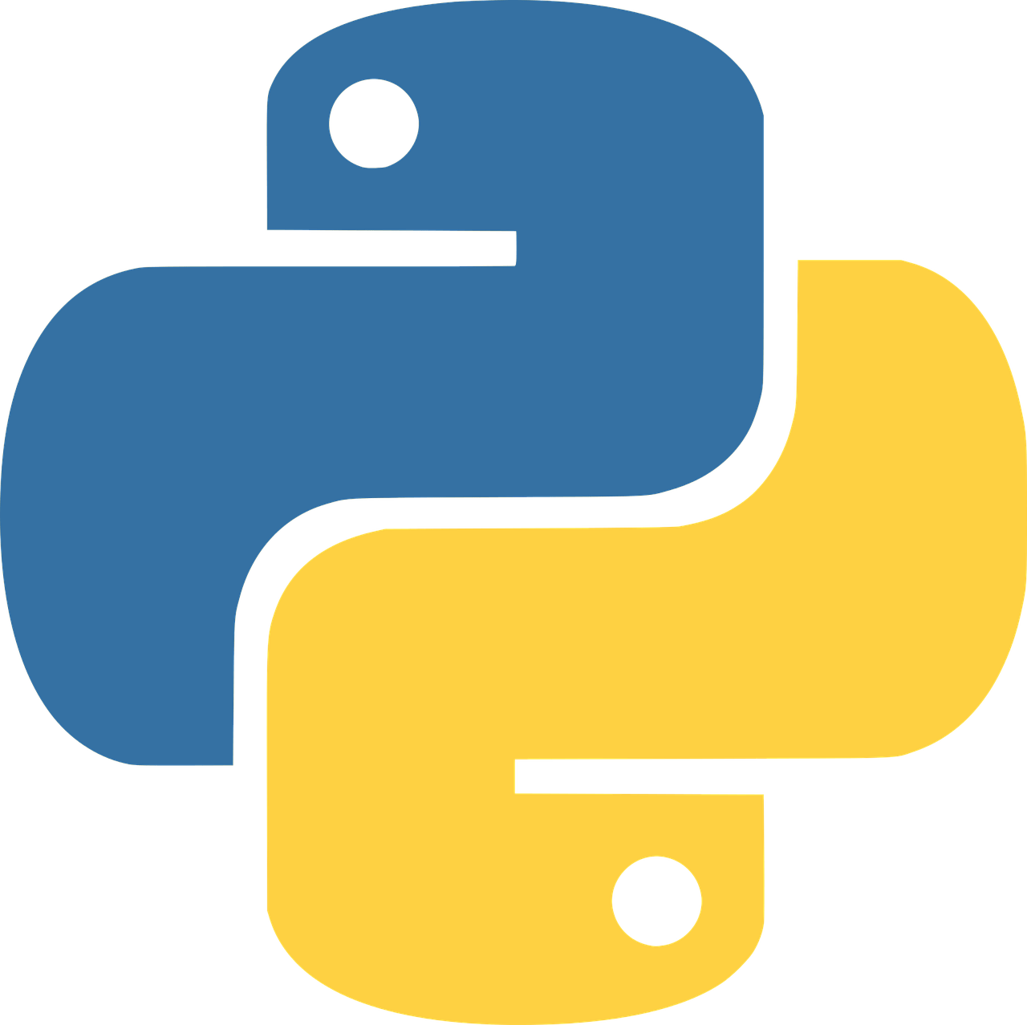

Python Programming Practice Projects
By: Bon Lee

Slide 4

20+ IT Industry Experience
Python Programming
Data Analytics
Machine Learning

